Slide 1
Rekindling The Fire Gathering
Carleton University, Ottawa
June 11 & 12, 2023

Slide 2
syilx Inherent Rights

Slide 3
axá iʔ sccuntət iʔ tl x̌aʔxítət x̌l iʔ nəqsil̓tət FAMILY DECLARATION
iʔ k̓ʷl̓ncutn naʔł snk̓lip² mnim̓łcəl̓x iʔ t̓k̓ʷntisəlx iʔ sc̓x̌ʷəx̌ʷíplaʔ k̓l kłcaw̓tsəlx iʔ sqilxʷ. kcx̌aʔx̌aʔstím iʔ sc ͜ c̓ax̌ʷsəlx iʔ kł ͜ n̓xʷl̓xʷl̓tans, k̓l kł ͜ nx̌stans iʔ sqilxʷ, k̓l t̓ə sxʷuys. iʔ tm̓xʷúlaʔxʷ³, iʔ tmixʷ⁴ naʔł mnim̓łtət t̓iʔ kʷu snaqsx
Creator and Coyote laid down our laws/responsibility for us, sqilxʷ/ syilx/sʔuknaqínx, to carry for all time. We hold in high regard their decree and teachings of accepting the responsibility to be keepers of our waters, territory, lands, foods, and resources. The Land, all creation, and us, as sqilxʷ/syilx/sʔuknaqínx People, are one.
axá iʔ sccuntət iʔ tl x̌aʔxitət x̌l iʔ nqsil̓tət Family Declaration – Okanagan Nation Alliance (syilx.org)
https://www.syilx.org/wp/wp-content/uploads/2022/08/Family-Declaration-2022.pdf

Slide 4
Educating our Members about self inherent rights and the Indian act

Slide 5
Five Priorities
1. EnoWkInWIXw & cAptikw]
2. Jurisdiction :
Consultation & syilx inherent rights
Our Relations (Child and Family) Law, Bill C-92 and beyond
3. Health
4. Strategic transition
5. Economic Development

Slide 6
Building Capacity Through Policy Development
All policies reviewed by RFNG reps
Policies to amend: Land Allocation, Post-Secondary, Rental Housing,
Policies to draft: Referendum Policy
Continue list

Slide 7
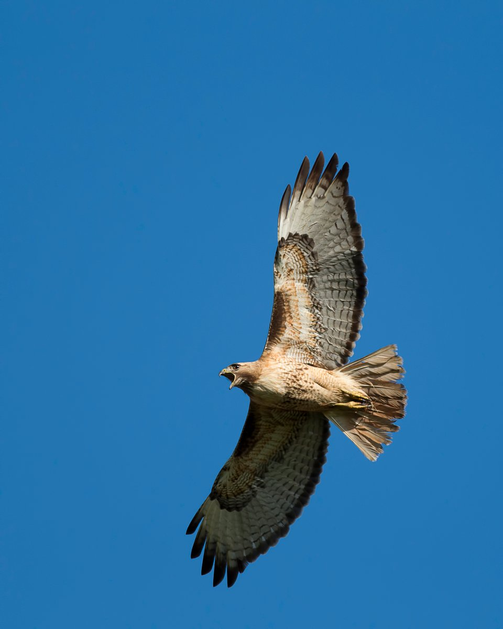
To-Do List
Develop syilx inherent rights framework to include:
Declaration
Constitution
Motion from members to opt into syilx inherent rights
Empower/appoint Transitional Government
Develop Communications Strategy to continue to engage our rights holders

Slide 9
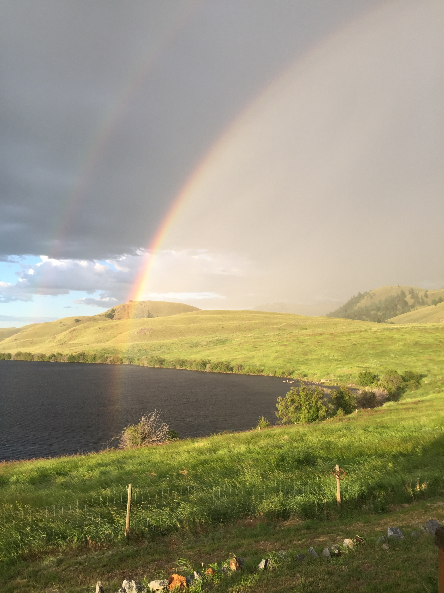
Contact
1913 Chief John Chilheetsa stated “…If you claim it is your country then we are of opposite opinions and I am opposed to that view…” (We Get Our Living Like Milk From the Land, Armstrong)
Upper Nicola Band
Collette Sunday
Band Administrator
E: admin@uppernicola.com T: 250-350-3342

